Slide 1
Machine Learning Goes to High School
John Chapin -
chapin@vt.edu http://bit.ly/mlgoestoHS
32 Machine Learning High School Juniors (Post AP CS) -

Slide 2





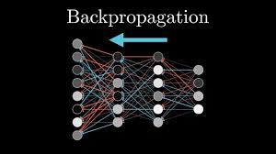

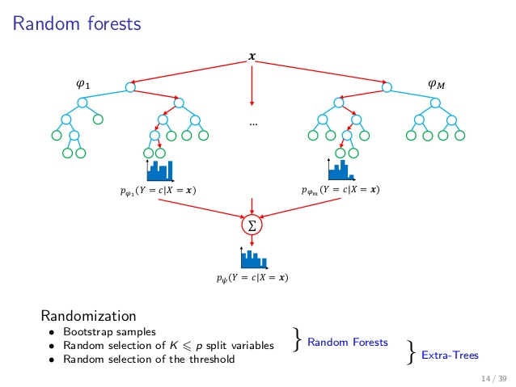



18 Months Ago

Slide 3



Had lots of expert advice
Andrew Ng

Slide 4
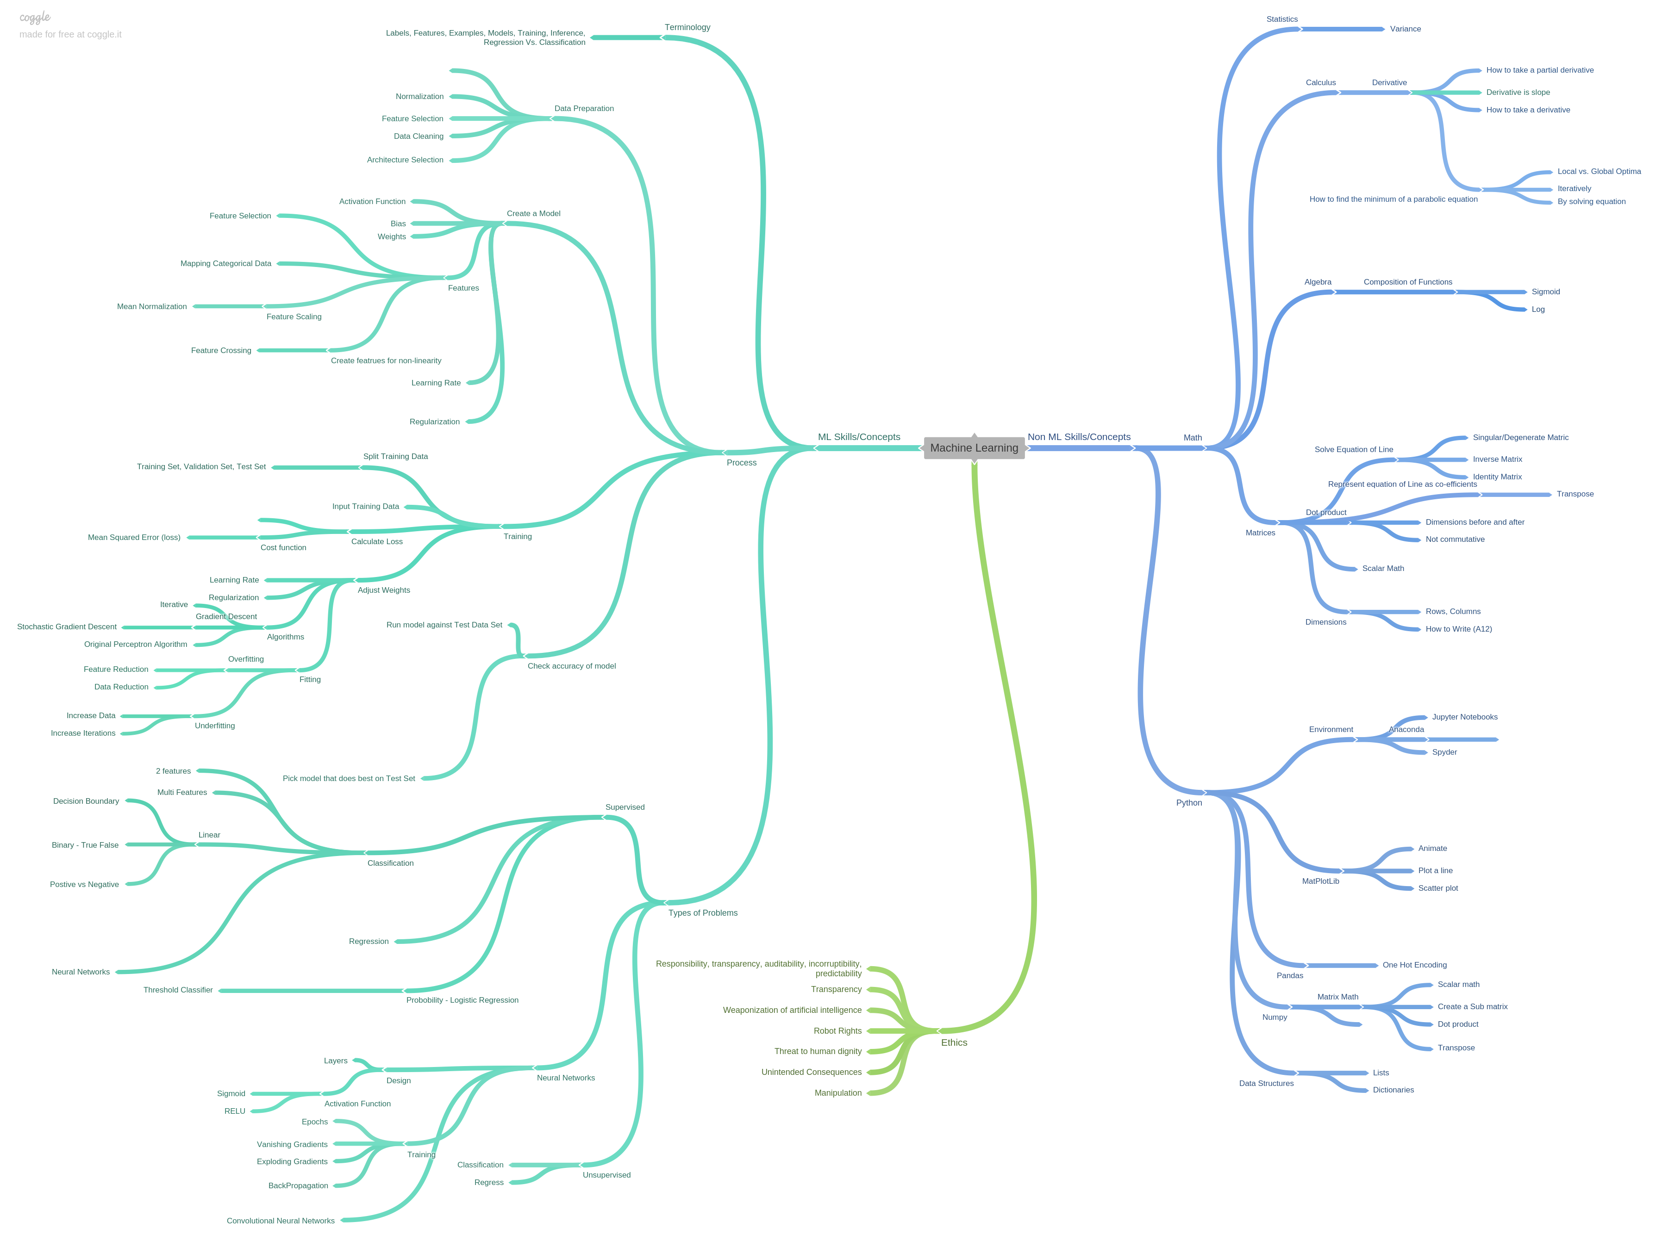
Ahhh…. Organize…
but can they learn it?

Slide 5

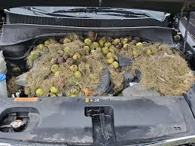
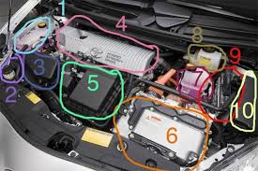
Black Box or get under the hood?
VS

Slide 6
Under the Hood Process
Code the Algorithm
Intuitive Understanding
Analyze and Interpret the Data

Slide 7
Progression
Increase complexity
Neural Networks & Other Algorithms
Basics
Backprop by Hand
Larger datasets
Different cost functions
Activation functions
Logistic Regression
Linear Regression
Understand the process of Gradient Descent
How
Why
Components
LR, Cost function, Gradient Function
Black box
Final Project
Pick a Problem and solve it
2-3 weeks
Science Fair format
Keras
Perceptron
Ethics, Data Cleaning/Interpretation

Slide 8
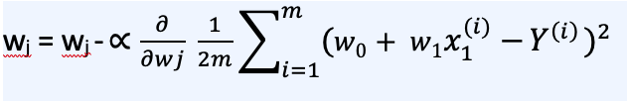

But these are not college students

Slide 9
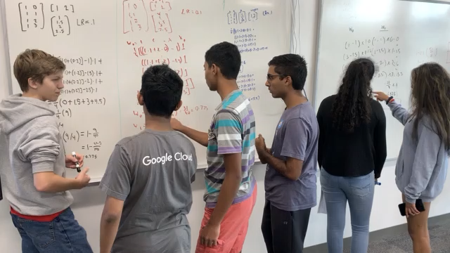
Visualize their thinking and scaffold debugging
Intro to concepts
Hand Calculate simple example
Code Simple Example
Code Classic Dataset
Analyze Multiple Datasets
MNIST, Housing, Iris, Titanic
3blue1brown
unplugged
Kaggle
Whiteboard
Truth table,
Random data
Variable values from hand calculation

Slide 10
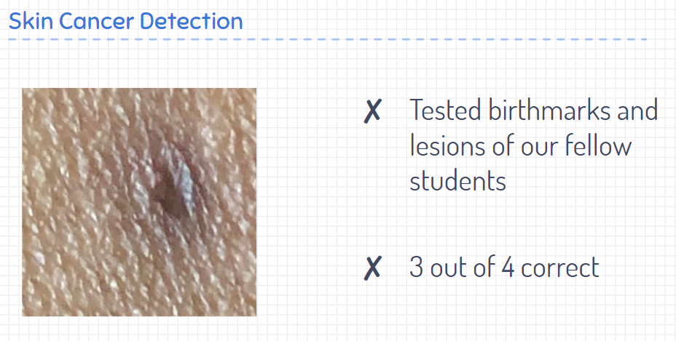
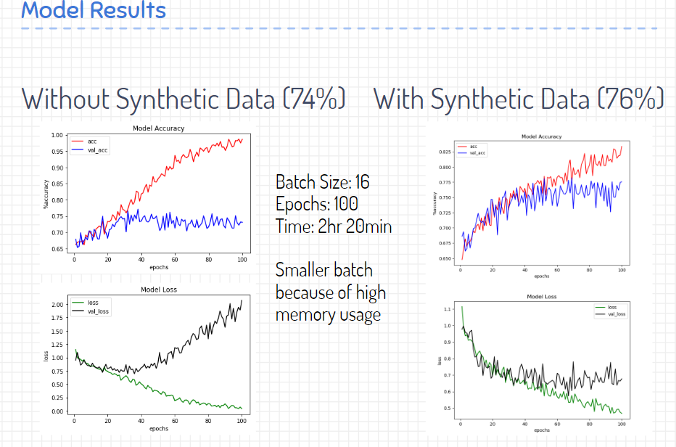
Real World Data – Real Impact

